Slide 1
CUSTOMER SUCCESS DASHBOARD ANALYSIS
BY AMIT SARKAR

Slide 2
BUSINESS OBJECTIVES
The company name Big shoppers wants to see their online shop
They want to know the customer state, sales revenue,customer,product etc
Looking up the areas where they have to work on.
It also helps them to increase their sales and so that they more focus on the online shop.

Slide 3
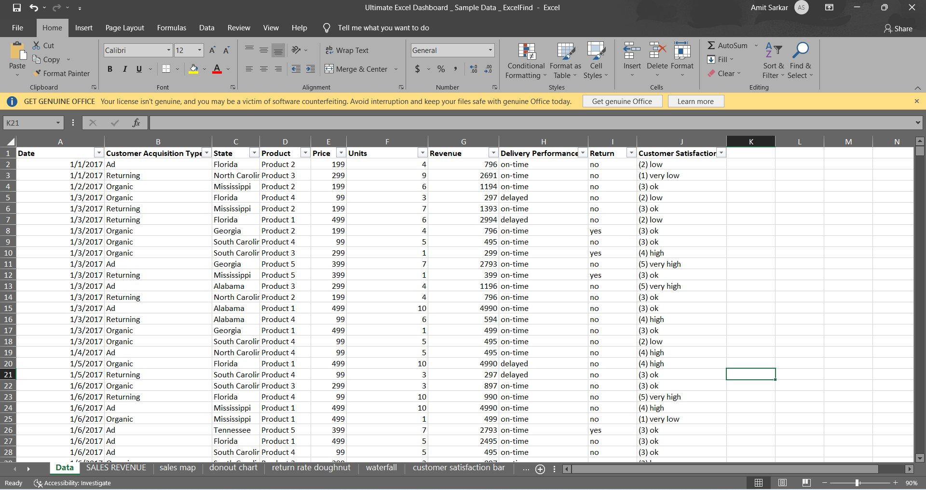
SAMPLE DATA

Slide 4
DATA PROCESSING
CLEANING DATA
CREATING DATA TABLE
RESEARCH
SUMMARIZATION
FINAL TOUCH
DASHBOARD

Slide 5
SALES REVENUE
In this chart we see that in the month of July the sales revenue is highest
In the month of feb the sales revenue is the lowest.

Slide 6
From the above donut chart we see that 67% of order have delivered on time
And 32% of the order have been delayed by the customer.

Slide 7
I
From the above donut chart we see that 89% of order have didn’t returned
while 10% of the order have been returned by the customer.

Slide 8
BUSINESS INSIGHTS
In the month of has the highest sales revenue
The state south Carolina has the highest revenue
Product 3 has the highest no of satisfaction while product 2 has the lowest no of satisfaction
The highest no of customer acquistion is by done AD

Slide 9
THANK YOU

